Slide 1

Event Bus as Backbone for Decoupled Microservice Choreography Presentation, Discussion and Handson Workshop
Lucas Jellema
June 1st 2017, AMIS, The Netherlands
Notes:
Microservices are independent, encapsulated entities that produce meaningful results and business functionality in tentative collaboration. Events and pub/sub are great for allowing such decoupled interaction. Using Apache Kafka as robust, distributed, real-time, high volume event bus, this session demonstrates how microservices implemented in Java, Node, Python and SQL collaborate unknowingly. The microservices respond to social (media) events - courtesy of IFTTT - and publish results to multiple channels. The event bus operates across cloud services and on premises platforms: both the bus and the microservices can run anywhere.
presentation summary
- intro microservices objectives, focus on decoupled collaboration
- demo four mservices in different technologies; no direct dependencies
- outline desired choreography, use of events and need of event bus
- intro Kafka
- demo pub and sub from each mservice to Kafka
- link IFTTT to Kafka
(for demo: use ngrok to expose local Kafka to IFTTT cloud)
- demo end-to-end Social event=>IFTTT=>Kafka=>choreographed mservices=> final result
- discuss cloud deployment of event bus + mservices

Slide 2

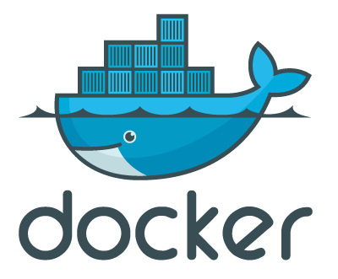
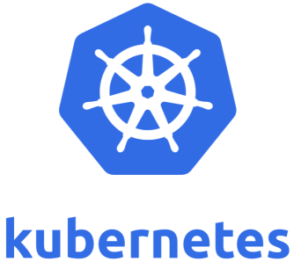

Agenda
Introduction of microservices - objectives, traits, implementation
The making of a microservice (demo)
The microservices platform - generic capabilities
Using events for decoupled interaction and workflow choreography
Introduction of Apache Kafka for implementing the Event Bus
Microservices and Event Bus in a hybrid world – cross on-premises and clouds
Implementing a multi-microservice workflow with event based choreography
Design, architecture, implementation and live demo
Music maestro – demonstrating event based workflow choreography by microservices
Hands On Workshop – Trying out Microservices, Event Bus, Kubernetes and Choreography

Slide 3
Microservice objectives (because of enterprise objectives)
Flexible, agile (Dev)
Functionality evolves rapidly with little effort
Easy quick rollout
Low impact
Manageable Non Functionally (Ops)
Scalable – handle flexible workload (horizontal scaleout)
Available – deal with failing nodes
Comprehendable
Dependencies, Impact, Implementation, deployment, operations
Ownership (culture, organization, process)
One team can do functional and technical evolution and deployment continuously and independently

Slide 4
Microservices how
Extremely decoupled (from other, non owned microservices | IT components)
Functionally
Non functionally – platform
Stateless (especially session-state less)
Stand alone
Deployable, manageable, scalable
Container
DevOps team
“You build it, you run it, you fix | evolve it”

Slide 5
Standing on shoulders of giants
Monolith++
API
Scale out
Automated CI/CD
SOA++
Stateless
HTTP native (REST)
Multiple tiers & platform components included
Deployable

Slide 6
Microservices how
Public APIs in standardized protocols
Deployable on enterprise standardized microservices platform
Omnia mea porto mecum - no external dependencies…
…except:
Calls to public APIs (exposed for example by microservices)
Usage of platform facilities
Generically available via contract
Injected via parameters
No sharing of data or other private resources across microservices
Stateless and Horizontally scalable
No session state, no client stickyness
Potentially micro-silo with multiple tiers (including UI)
Any implementation technology
that can run on the platform

Slide 7
Microservices platform
API Gateway
Authenticate
API
API
API
Receives microservice deployment
Handles scale out & fail over
Start/stop microservice instances based on non functional requirements and live observed behavior
Supports automated DevOps
CD, monitoring, …
Provides Capabilities – generic facilities available to microservices from the run time platform
Provided through public APIs whenever possible
Injected meta-data at run time
implemented by generic/platform level microservices
Logging
Cache
Microservices Platform
deploy, inject dependencies, start, watch, restart, stop, scale

Slide 8

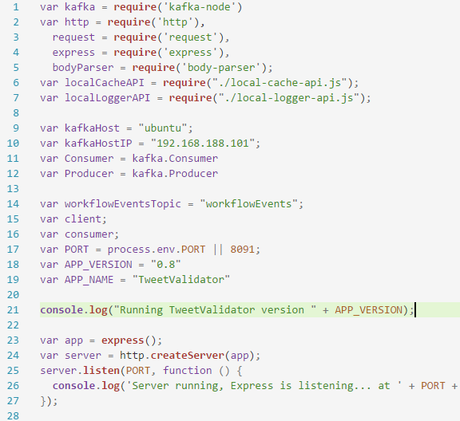
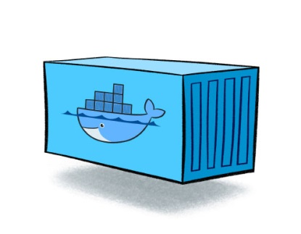
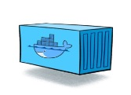
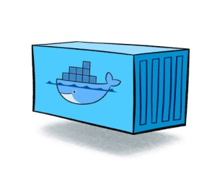


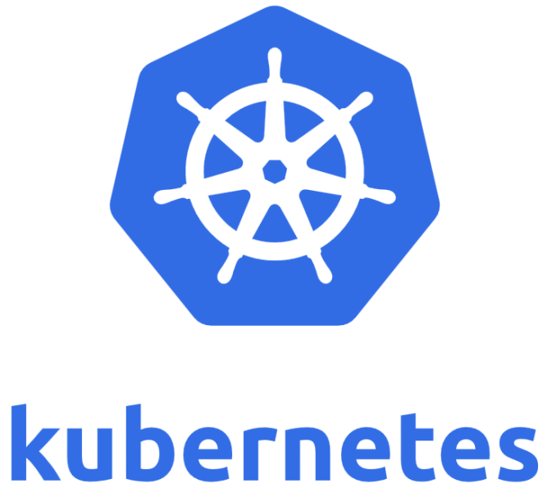
The making of a microservice
Service.yaml
Dockerfile
Pod.yaml
Volume (Storage)
Config & Depency Injection
npm
Node Docker Image

Slide 9
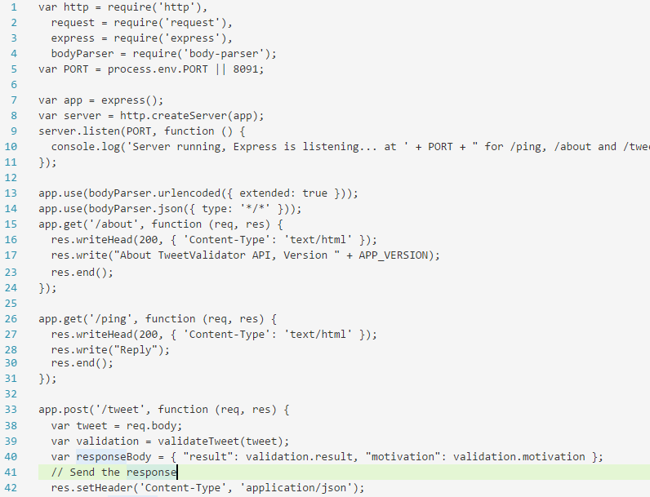
Microservice business functionality

Slide 10
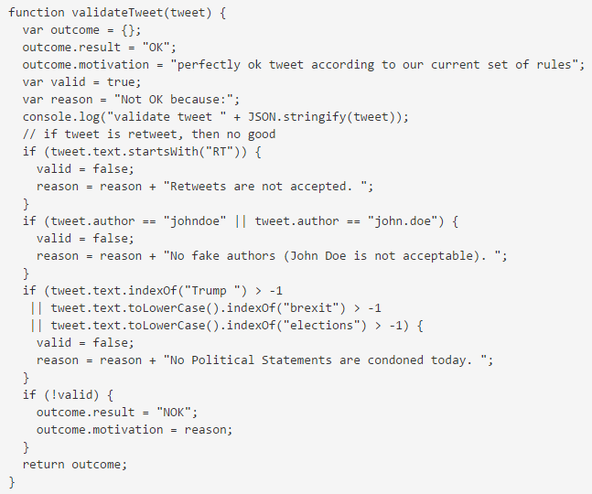
Microservice business functionality

Slide 11
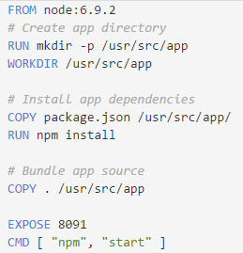
Docker File
docker build -t lucasjellema/tweet-validator .
docker tag tweet-validator lucasjellema/tweet-validator
docker push lucasjellema/tweet-validator

Slide 12
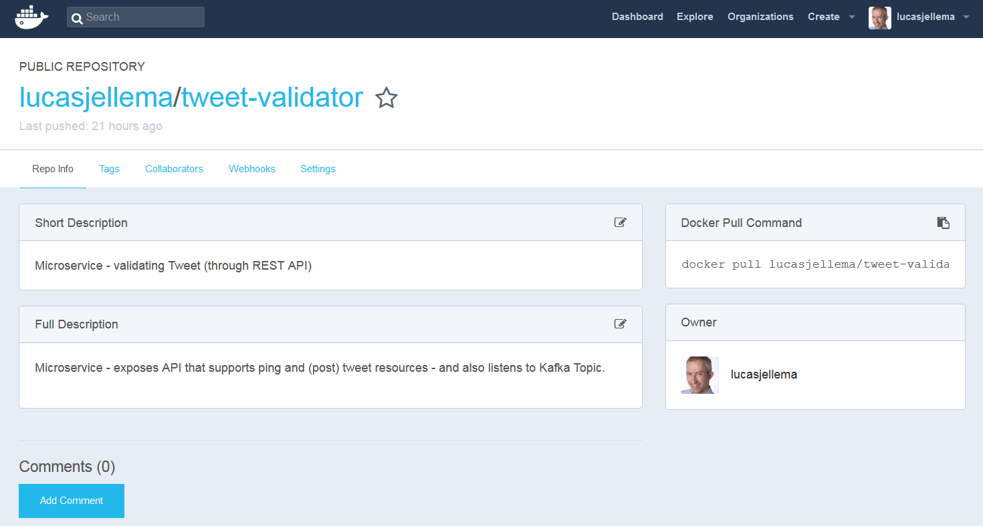
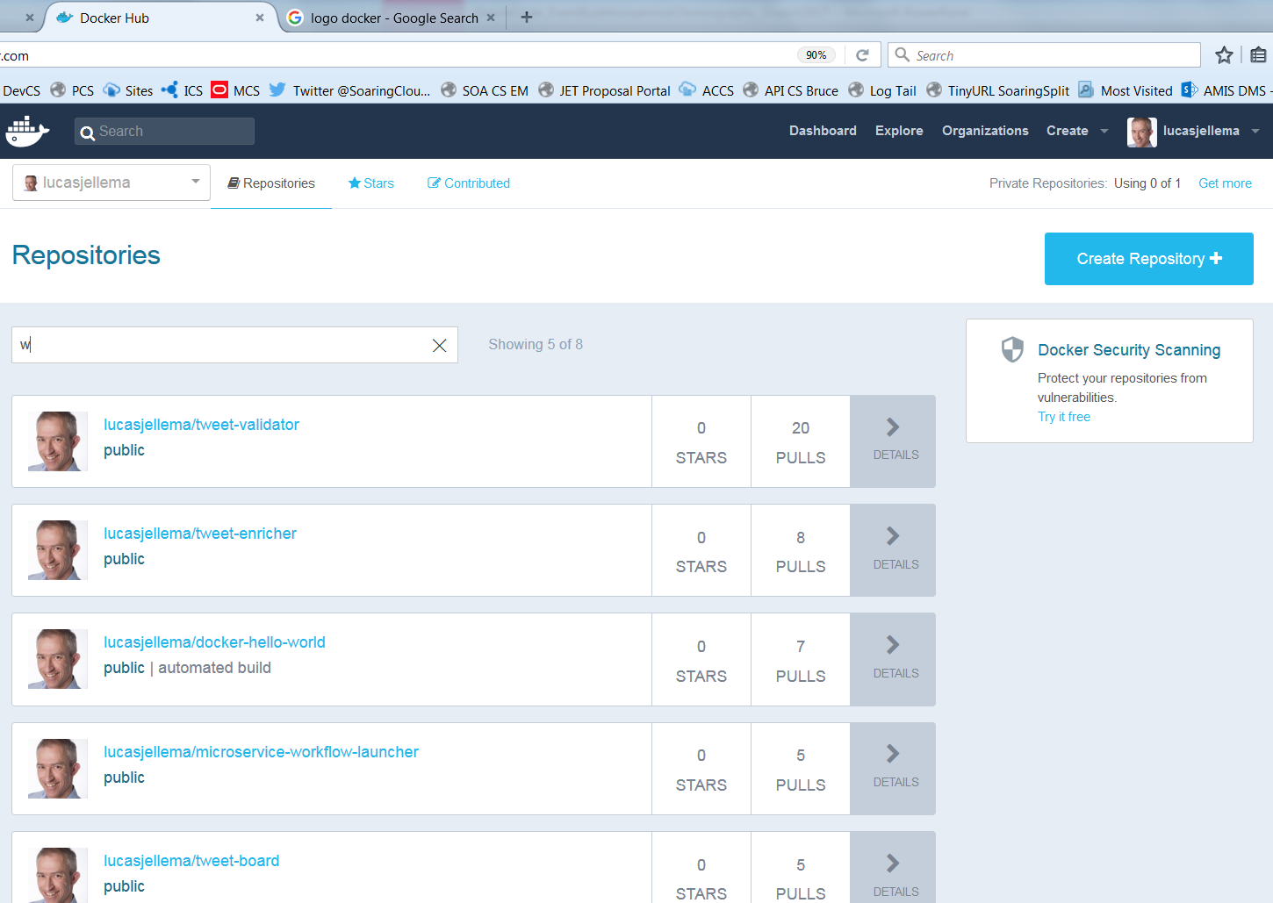
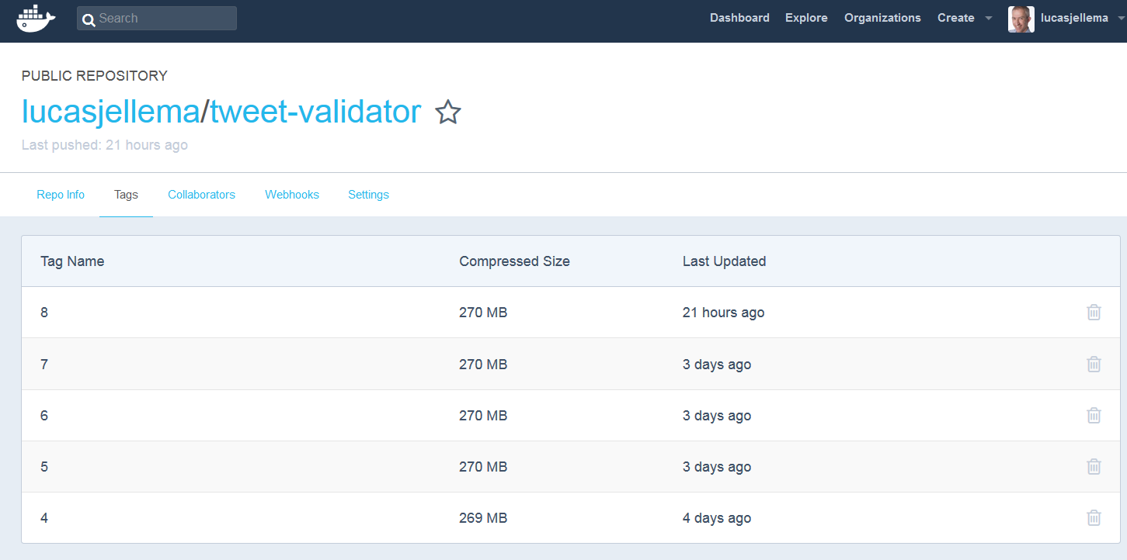
Docker hub

Slide 13
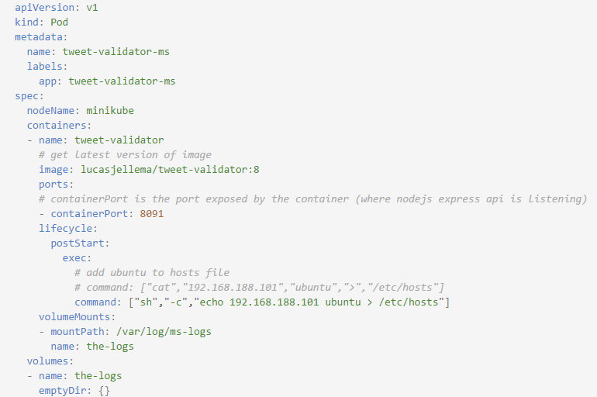
Kubernetes POD YAML file

Slide 14
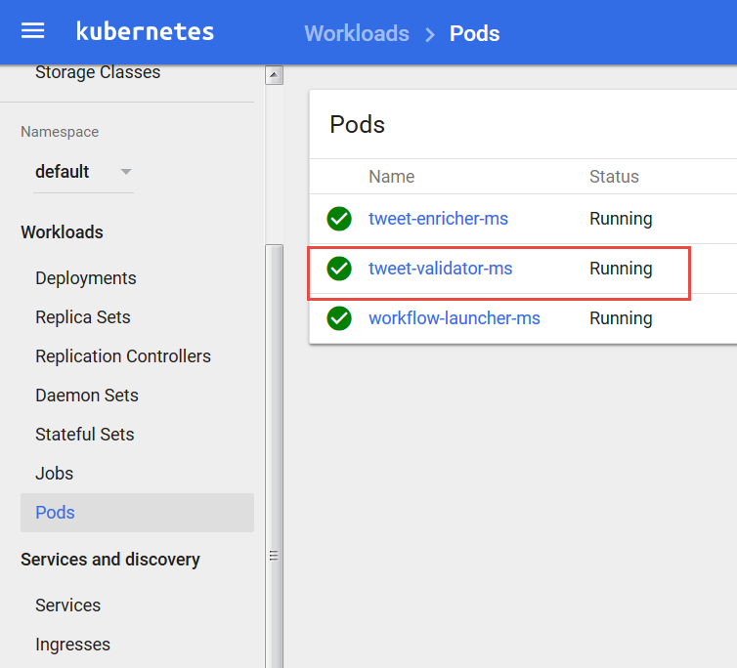
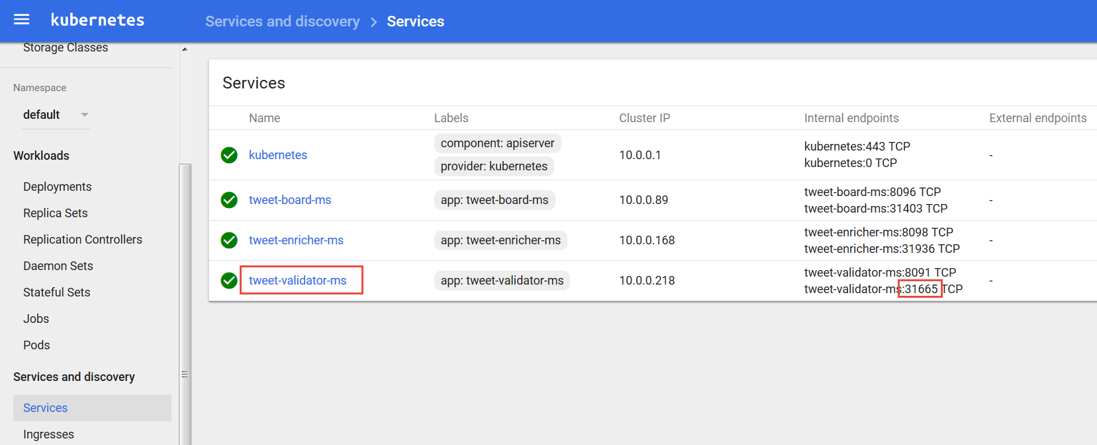
Running POD in Kubernetes

Slide 15
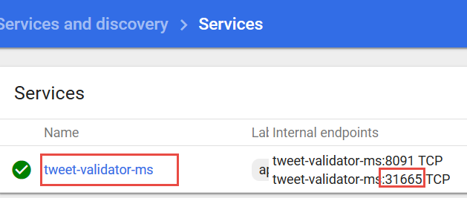
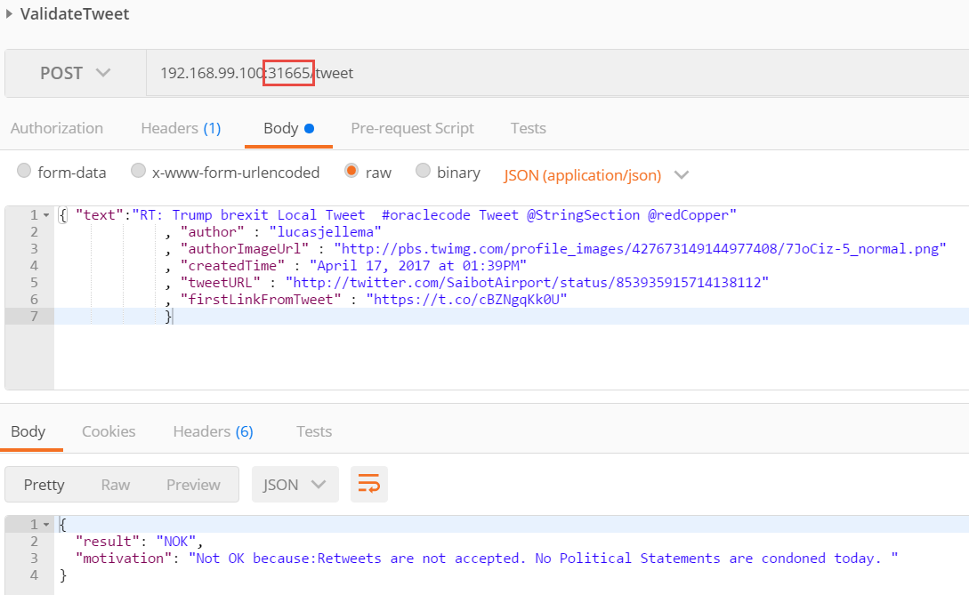
Invoke microservice API

Slide 16
Shared platform capability
Microservices are isolated
Not aware of each other (except through public APIs)
Not sharing private resources
Ideally each microservice brings its own platform
To prevent run time environment from being out of synch and creating dependency/impact between multiple platform users
However: At some level, sharing is inevitable Storage, Compute, power supply, building
In practice: having full blown RDBMS or Java EE server or Kafka cluster as part of a microservice may be unfeasible
Even if Docker images are light weight from layering – the run time resource usage is probably not
One approach: forbid use of heavy platforms
Alternative approach: provide generic ‘heavy duty’ platform capabilities, available for use in any microservice in a standardized way
If you need it, you can make use of your own private Oracle Database 12c Schema (or PDB) with the following features available to you … ; recovery can be performed in the following ways and under these conditions.

Slide 17
Microservices cross platform Capabilities
Authentication
Persistent Storage
Cache
Load balancing/API Gateway
Discovery/Lookup
Monitoring
Functional/Business KPIs
Non Functional Platform/Container & Infra
Audit, Usage tracking, Billing
Notifications and alerting
Logging
Relational Database Capability
Usage Tracking
API
UI
Notification
UI
API
API
Authentication
Logging
Microservices Platform
Cache

Slide 18
Example system architecture
API
API
NodeJS & Express
REST/JSON
REST/JSON
Widgets
HTML 5 Web Component
Usage Tracking
UI
API
REST/JSON
API
UI
Notification
API
UI
Authentication
API
Legacy Application
Logging
Python & MySQL
Java / Spring Boot
NodeJS & Express & MongoDB
Strangler
Cache
WebLogic & Oracle Database
Redis
Microservices Platform
Storage
Notes:
https://www.martinfowler.com/bliki/StranglerApplication.html
https://dzone.com/articles/why-springboot

Slide 19
Trends, challenges, common
Use of containers and container management
Docker Containers – layered, packaged & shippable, registry
Docker Container Management: Composer, Mesos, Swarm or Kubernetes
Application Container platform such as Google App Engine, Azure App Service, Oracle Application Container Cloud, AWS Beanstalk
Serverless computing – AWS Lambda, Oracle Functions
Use of cache for [state of] longer running conversations
Transaction, session, workflow, business process
New ways to consider data
Every microservice owns the data it requires – data denormalization and duplication of data across microservices is a logical consequence
Command Query Responsibility Segregation (CQRS) and Event Sourcing
Orchestration | Choreography across microservices

Slide 20
Events
Consumers
Producers

Slide 21
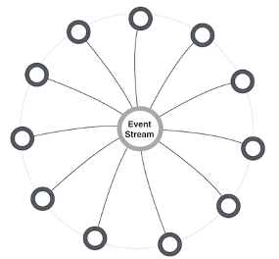
MicroserviceS and events
Report business events [without knowing to whom and without expecting a response]
Allowing interested microservices to respond – for example trigger serverless functions
Provide response to stateless caller – with conversation key
Choreograph cross-microservice workflow | process
Inform workflow | process orchestrator | job scheduler about activity status
Enable distributed transaction – commit and rollback/compensate
Make data events available for event sourcing
Allowing microservices to maintain their own [derived] data set
Synchronize cache refresh
Informing any microservice caching data about the need to refresh specific records
Hand systems events & metrics to monitoring service
Extreme decoupling – microservice choreography
Microservice never call each other, not even through public API; all interactions are through events
Notes:
http://microservices.io/patterns/data/event-driven-architecture.html
http://eventuate.io/whyeventdriven.html
http://www.kennybastani.com/2017/01/building-event-driven-microservices.html

Slide 22
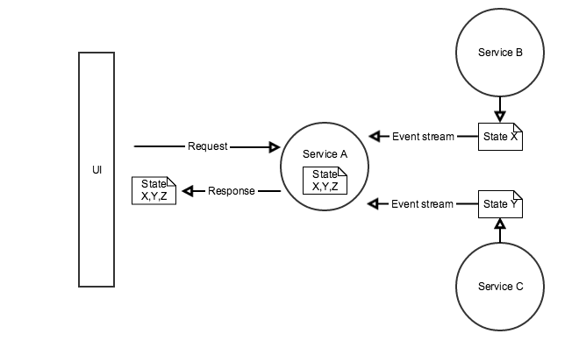
Microservice Workflow Choreography
Multi step process
Each step in different microservice
Multiple approaches
Orchestrator – running the process by invoking the required microservices subsequently, responding either to synch response, asynch callback or event
Choreography – allow the required microservices to react to relevant events
Act when it is your turn (as determined by routing slip?)
Share state through cache with claim check in routing slip
When done, publish updated routing slip
Possibly implement compensation handler
Notes:
http://www.dreweaster.com/blog/2016/05/08/the-art-of-microservices-integration-using-service-choreography/
End-to-end autonomy (each microservice leverages event sourcing to maintain the state it needs (even though it does not own it)
https://www.slideshare.net/CAinc/hypermediadriven-orchestration-in-microservices-55985377

Slide 23
Requirements for Event capability in microservices platform
Provide decoupling between publisher and consumer
Generally accessible for all microservices
Across the platform
Using standardized protocols and formats for communications and event payload (http, JSON)
Scalable (handle high loads)
Available (allow speedy event publication)
Reliable (do not lose events, at least once delivery)
Event Ordering (deliver events in the order of publication)
Retain Event History
Manageable at scale
Event Catalog – which events are published, what do they mean and what is their payload
Harvested from microservices

Slide 24


Introducing Apache Kafka
..- 2010 – creation at Linkedin
Message Bus | Event Broker
High volume, low latency, highly reliable, cross technology
Scalable, distributed, strict message ordering, ….
2011/2012 – open source under the Apache Incubator/ Top Project
Kafka is used by many large corporations:
Walmart, Cisco, Netflix, PayPal, LinkedIn, eBay, Spotify, Uber, Sift Science
And embraced by many software vendors & cloud providers
Client libraries available for NodeJS, Java, C++, Python, Ruby, PHP and many more

Slide 25
Kafka terminology
Message
Topic
partition
Message
== ByteArray
Broker
replicated
Producer
Consumer
Working together in Consumer Groups
Key
Value
Time
Producer
Consumer
Broker
Topic

Slide 26
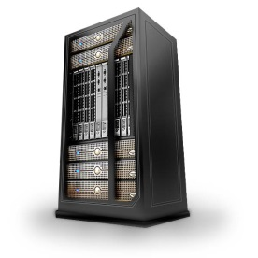

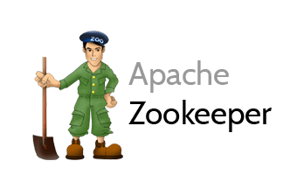
Consumers
tcp
Producers
tcp
Broker
Topic

Slide 27
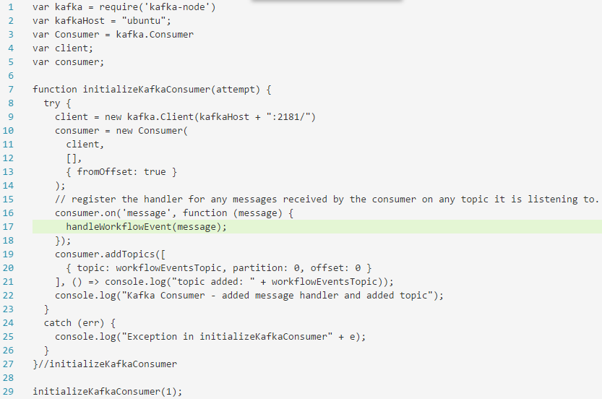
Connect microservices to KAFKA – NODEJS Example

Slide 28
Extended API of microservice
API
Deployment API
Injectable dependencies – reference to cache, logging, storage URL, …
Configurable meta-data – run time parameters, log level, credential (key)
Interaction API
REST Resources & Operations – query and URL parameters, message formats
Events Consumed – alternative way to call | activate a microservice
Reference to entry in Event Catalog
May include reference to shared Cache Resource
Events Produced – alternative output from microservice
Event can be an asynchronous response to a stateless consumer

Slide 29
Event bridge to connect cloud & on premises Event bus
An event bus based on Apache Kafka can run on premises and in the cloud
Various cloud vendors offer such an Apache Kafka service
For example Oracle Event Hub CS
In a hybrid landscape – both on premises and in-the-cloud microservices – two event buses can be used with a bridge between the two
Or more if multiple clouds are part of the landscape
EventHub CS
EventHub CS
On premises
Event Bus

Slide 30
Event bridge to connect cloud & on premises Event bus
API
API
API
API
EventHub CS
EventBridge
EventBridge
EventBridge
On premises
API
API
API
API
API
API
Event Bus
Microservices Platform

Slide 31

Desired Workflow
done
Tweet about OracleCode
Validate Tweet
No simple retweet, no black listed words used, no known robot tweeter or otherwise excluded authors, no undesirable location
Enrich Tweet
Add Tweet to TweetBoard
Publish TweetBoard
Details about author, location, hashtags, acronyms and abbreviations used in tweet
Add the tweet to the top of the TweetBoard – a list of recent, relevant tweets
Publish the TweetBoard through API and UI (HTML web document)

Slide 32

Microservices to map workflow to
TweetBoard
EventHub CS
Apache Kafka
UI
API
Cache
Oracle Coherence
NodeJS & Express in ACCS
On premises
REST/JSON
Validate Tweet
REST/JSON
Enrich Tweet
API
API
Java SE
Java SE
Event Bus
Microservices Platform
Notes:
Workflow initiator responds to NewTweetEvent
Workflow Initiator - When tweet is for hashtag oraclecode then create routingslip document with tweet data, store in cache under key and publish workflow event for OracleCodeTwitterWorkflow with cache key for workflow state in payload
Validate Tweet – when OracleCodeTwitterWorkflow event – fetch workflow state from cache based on event payload, check routingslip to see if ValidateTweet should act; if so, validate tweet, update routing slip, retrieve and store in cache; publish workflow event for OracleCodeTwitterWorkflow with cache key for workflow state in payload
Enrich Tweet – when OracleCodeTwitterWorkflow event – fetch workflow state from cache based on event payload, check routingslip to see if EnrichTweet should act; if so, enrich tweet, update routing slip, retrieve and store in cache; publish workflow event for OracleCodeTwitterWorkflow with cache key for workflow state in payload
TweetBoard – when OracleCodeTwitterWorkflow event – fetch workflow state from cache based on event payload, check routingslip to see if TweetBoard should act; if so, add tweet to tweet list, update routing slip, retrieve-and-store in cache; publish workflow event for OracleCodeTwitterWorkflow with cache key for workflow state in payload
All microservices publish logging about their actions with the conversation identifier as part of the logging

Slide 33
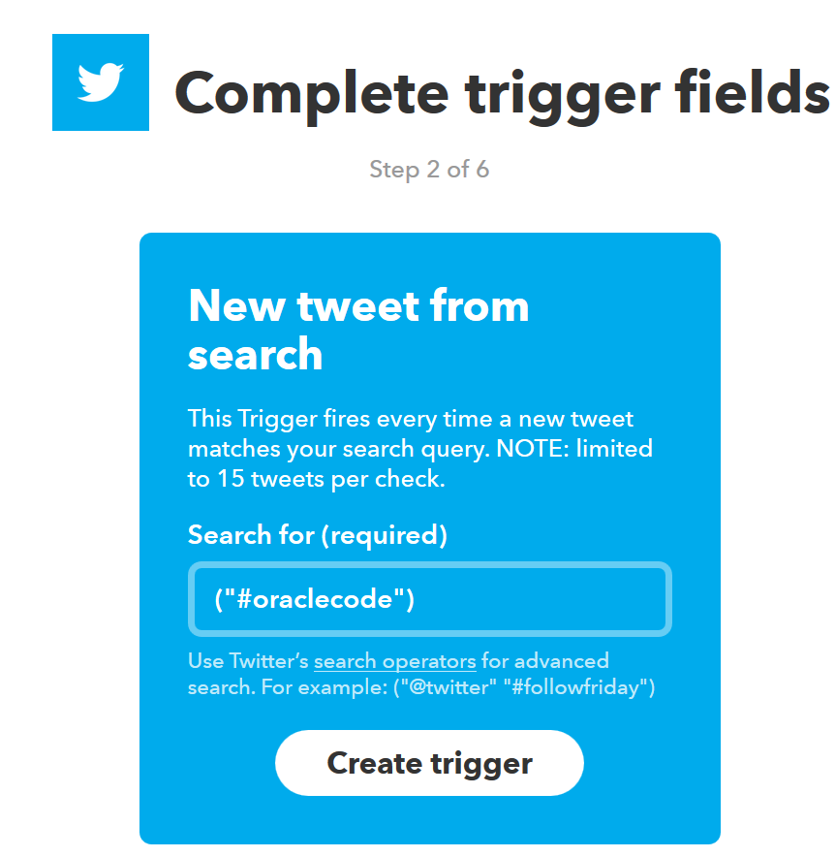

Configure the IFTTT recipe

Slide 34

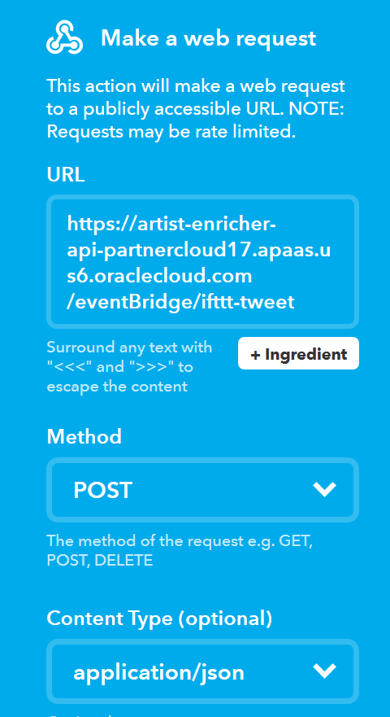
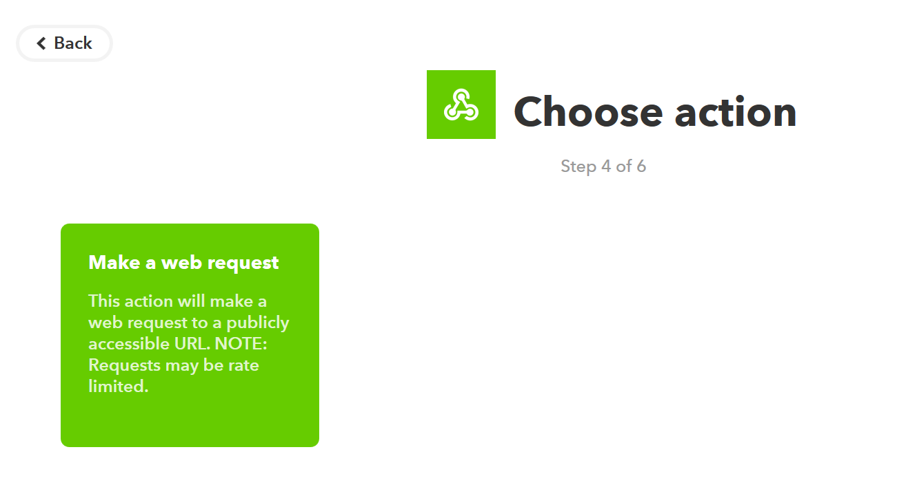
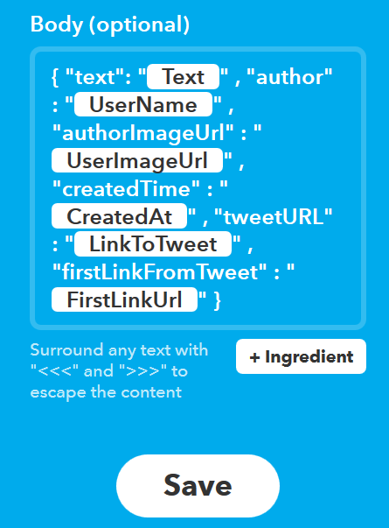
Configure the IFTTT recipe
#oraclecode
EventBridge
API

Slide 35
Choreographed workflow
EventBridge
TweetBoard
EventHub CS
Apache Kafka
#hashtag
API
UI
API
Cache
Oracle Coherence
On premises
EventBridge
API
Workflow Launcher
Event Bus
API
Validate Tweet
API
Enrich Tweet
Microservices Platform
Notes:
Workflow initiator responds to NewTweetEvent
Workflow Initiator - When tweet is for hashtag oraclecode then create routingslip document with tweet data, store in cache under key and publish workflow event for OracleCodeTwitterWorkflow with cache key for workflow state in payload
Validate Tweet – when OracleCodeTwitterWorkflow event – fetch workflow state from cache based on event payload, check routingslip to see if ValidateTweet should act; if so, validate tweet, update routing slip, retrieve and store in cache; publish workflow event for OracleCodeTwitterWorkflow with cache key for workflow state in payload
Enrich Tweet – when OracleCodeTwitterWorkflow event – fetch workflow state from cache based on event payload, check routingslip to see if EnrichTweet should act; if so, enrich tweet, update routing slip, retrieve and store in cache; publish workflow event for OracleCodeTwitterWorkflow with cache key for workflow state in payload
TweetBoard – when OracleCodeTwitterWorkflow event – fetch workflow state from cache based on event payload, check routingslip to see if TweetBoard should act; if so, add tweet to tweet list, update routing slip, retrieve-and-store in cache; publish workflow event for OracleCodeTwitterWorkflow with cache key for workflow state in payload
All microservices publish logging about their actions with the conversation identifier as part of the logging

Slide 36
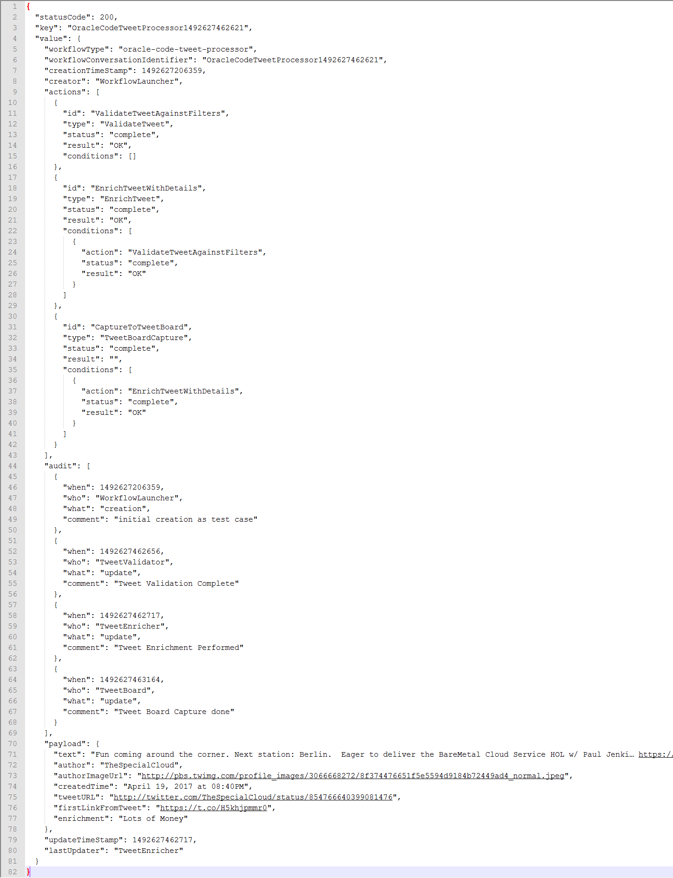
Routing Slip published by workflow Launcher

Slide 37
Choreographed workflow
EventBridge
REST/JSON
TweetBoard
EventHub CS
Apache Kafka
#hashtag
API
UI
API
Cache
Oracle Coherence
NodeJS & Express in ACCS
NodeJS & Express in ACCS
REST/JSON
On premises
EventBridge
API
Workflow Launcher
REST/JSON
REST/JSON
Event Bus
API
Validate Tweet
API
Enrich Tweet
NodeJS & Express
NodeJS & Express
Microservices Platform
Notes:
Workflow initiator responds to NewTweetEvent
Workflow Initiator - When tweet is for hashtag oraclecode then create routingslip document with tweet data, store in cache under key and publish workflow event for OracleCodeTwitterWorkflow with cache key for workflow state in payload
Validate Tweet – when OracleCodeTwitterWorkflow event – fetch workflow state from cache based on event payload, check routingslip to see if ValidateTweet should act; if so, validate tweet, update routing slip, retrieve and store in cache; publish workflow event for OracleCodeTwitterWorkflow with cache key for workflow state in payload
Enrich Tweet – when OracleCodeTwitterWorkflow event – fetch workflow state from cache based on event payload, check routingslip to see if EnrichTweet should act; if so, enrich tweet, update routing slip, retrieve and store in cache; publish workflow event for OracleCodeTwitterWorkflow with cache key for workflow state in payload
TweetBoard – when OracleCodeTwitterWorkflow event – fetch workflow state from cache based on event payload, check routingslip to see if TweetBoard should act; if so, add tweet to tweet list, update routing slip, retrieve-and-store in cache; publish workflow event for OracleCodeTwitterWorkflow with cache key for workflow state in payload
All microservices publish logging about their actions with the conversation identifier as part of the logging

Slide 38
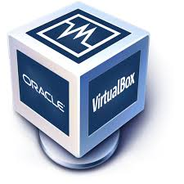
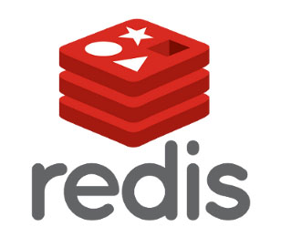
Microservice Choreography Topology
EventBridge
App Container CS
Cache
Cloud Service
EventHub CS
EventBridge
Workflow Launcher
Tweet
Validator
Tweet
Enricher
Tweet
Board
Event Bus

Slide 39
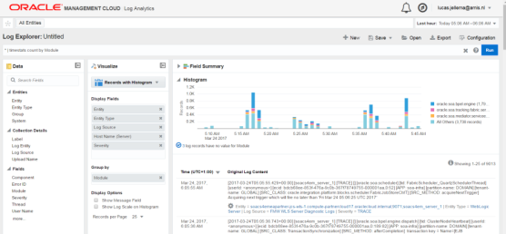
Logging in the Microservice Platform
Log Analytics
Oracle Management Cloud
EventBridge
App Container CS
Cache
EventHub CS
EventBridge
Workflow Launcher
Tweet
Validator
Tweet
Enricher
Tweet
Board
Logger
Event Bus

Slide 40
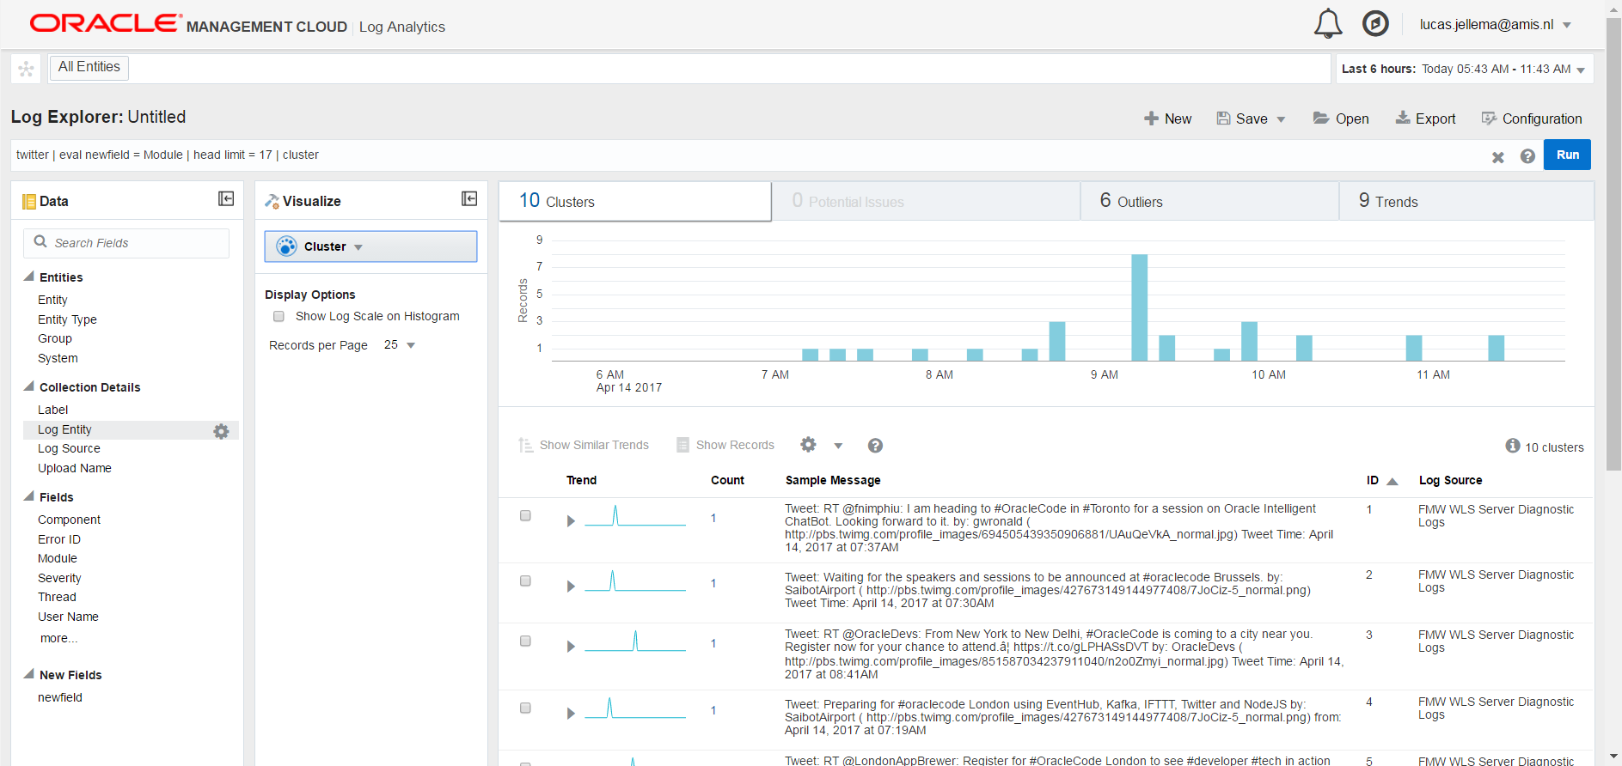
Demo Oracle Management Cloud Log Analytics System events – metrics and logging

Slide 41
Main technical challenges
Dockerize NodeJS applications
Run Docker container images in Kubernetes cluster
Pass environment variables and disk volumes
Expose services through ports
Link NodeJS applications in Kubernetes to Kafka Cluster in VirtualBox
Producing to and consuming from Topic
Kafka host needs to be in /etc/hosts file in Node.JS Docker Container
Leverage in-cloud cache from Kubernetes Pod members
Share workflow instance state across microservices
Create two-way EventBridge between local microservices and cloud

Slide 42
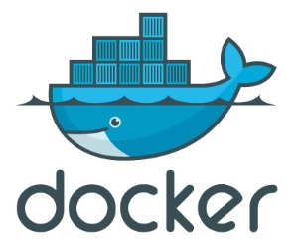
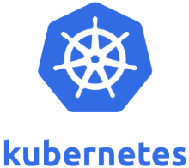

Summary
Microservices are about rapid rollout of scalable, available functionality
(session) Stateless, Continuous deployment, horizontal scale out
One team is owner of a microservice and can evolve and deploy independently
Microservice is understandable and manageable
Microservices contain everything that is special for their implementation
External dependencies only on generic platform capabilities and public APIs
Microservices expose a public API
REST resources & operations and events (consumed and produced)
Decoupled, Event-based interaction is crucial for microservices
Cache synchronization, Monitoring, CQRS, Event Sourcing, Choreographed workflows
The microservices platform should provide an Event Bus capability
Apache Kafka is a proven, popular Event Bus implementation – available in premises and in the cloud (for example through Oracle Event Hub CS)

Slide 43

Workshop
Install Virtual Box, Docker Machine, Kubectl & Minikube
Run your first Kubernetes Pod
Microservice RequestCounter
On Docker, on Kubernetes, Scaling, Stateless and backed by Redis Cache
Note: we use a generic Docker Image, capable of running Node.js application directly from GitHub
Event Bus powered by Apache Kafka and Microservices leveraging the Event Bus
Workflow Choreography based on Event Bus with microservices on Kubernetes

Slide 44
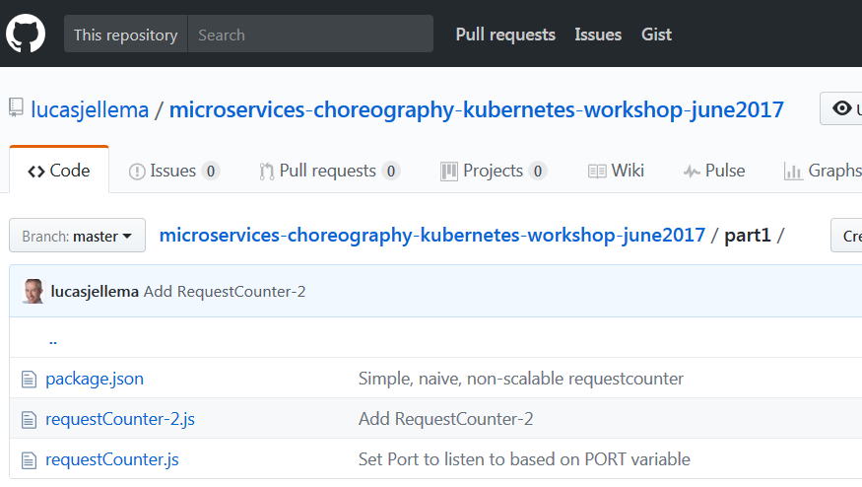
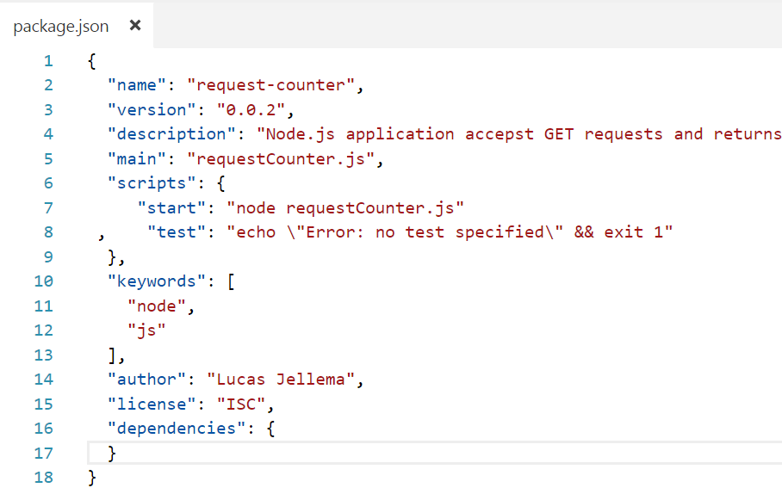

Create and commit a Node.JS application to Github
Commit Node Application

Slide 45


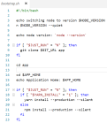

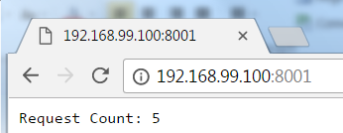
Run a Node.JS application from Github using generic container image
2. docker run:
port mapping
volume
3. clone from GitHub
run container
1. pull from Docker Hub registry
4. npm install
Specify:
GITHUB_URL
APP_HOME
APP_STARTUP
APP_PORT
NODE_VERSION
5. npm start or node app.js
6. access application

Slide 46

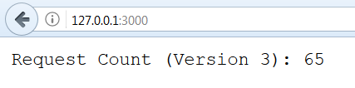
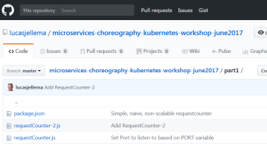
Dockerized Node.js application instances backed by REDIs cache
-p 8001:3000
-e GIT_URL APP_PORT APP_HOME
APP_STARTUP
REDIS_HOST
REDIS_PORT
-p 8002:3000
-e GIT_URL APP_PORT APP_HOME
APP_STARTUP
REDIS_HOST
REDIS_PORT
Port 8001
Port 8002
get Key “requestCounter”

Slide 47
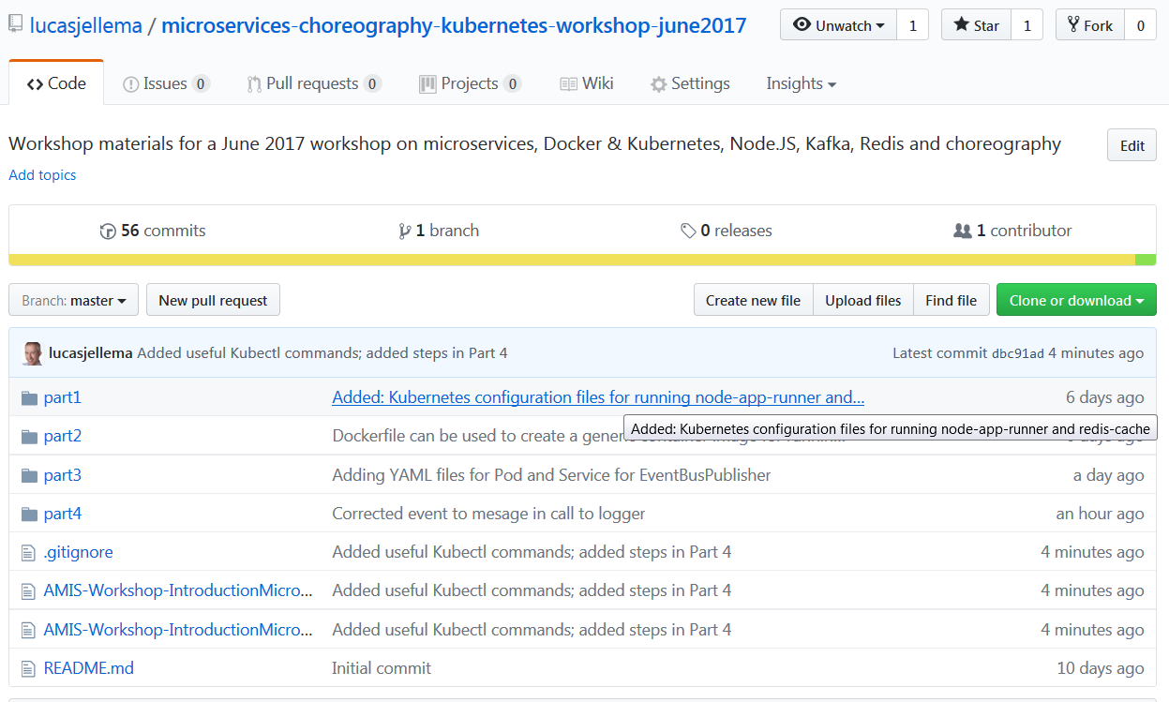
Workshop Resources
Workshop Resources are here:
https://github.com/lucasjellema/microservices-choreography-kubernetes-workshop-june2017

Slide 48
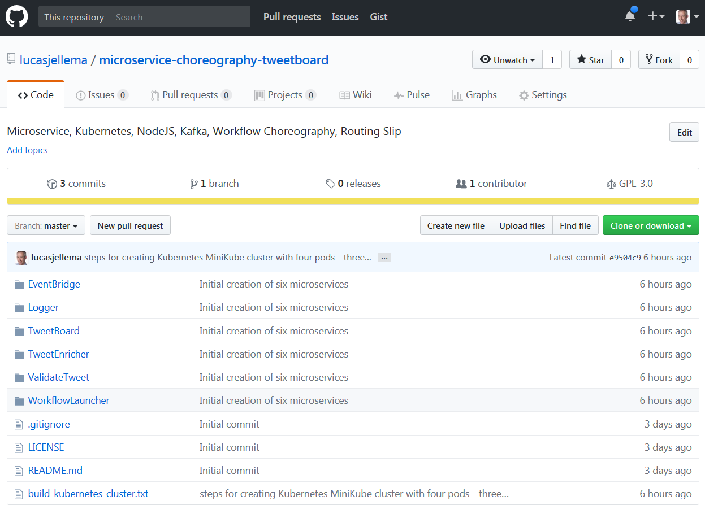



Happy Coding!
Source Code:
https://github.com/lucasjellema/microservice-choreography-tweetboard
Blog: technology.amis.nl
Email: lucas.jellema@amis.nl
: lucasjellema
: lucas-jellema
: www.amis.nl, info@amis.nl +31 306016000 Edisonbaan 15, Nieuwegein

Slide 49
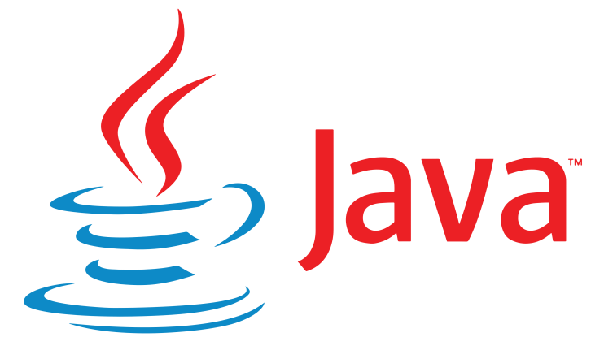
Create and commit a Java SE application to Github
Commit Java Application

Slide 50

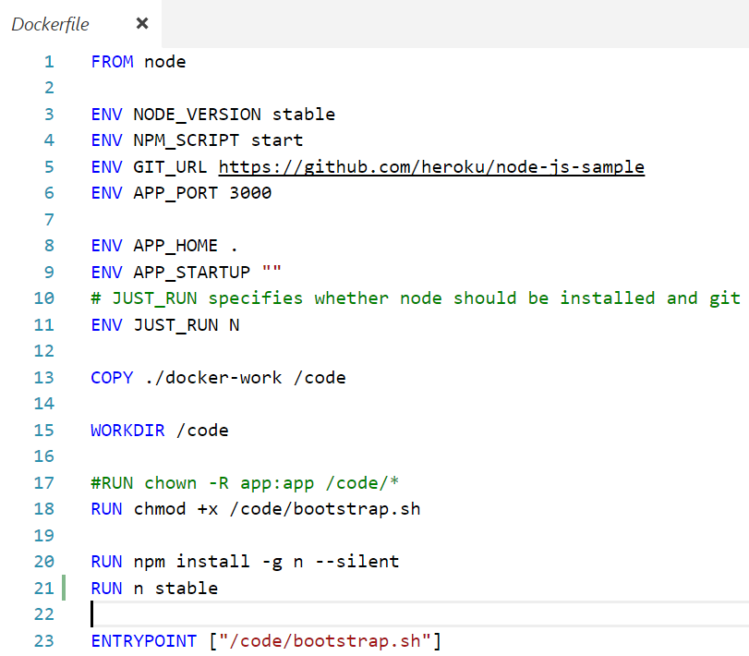
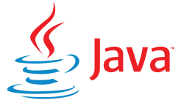

Build The generic docker container image “to Run a Java SE application from Github”
bootstrap.sh
Dockerfile
Node Docker Image
push to Docker Hub registry

Slide 51
Run a Node.JS application from Github using generic container image
2. docker run:
port mapping
volume
3. clone from GitHub
run container
1. pull from Docker Hub registry
4. mvn install
Specify:
GITHUB_URL
APP_HOME
APP_STARTUP
APP_PORT
5. java –cp …
6. access application

Slide 52
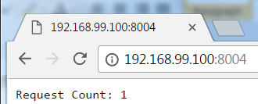
Run a Java SE application from Github using generic container image
2. docker run:
port mapping
volume
run container
1. pull from Docker Hub registry
Specify:
GITHUB_URL
APP_HOME
APP_STARTUP
APP_PORT

